Slide 1
Walking Motion Control in Partial Immersion

Slide 2
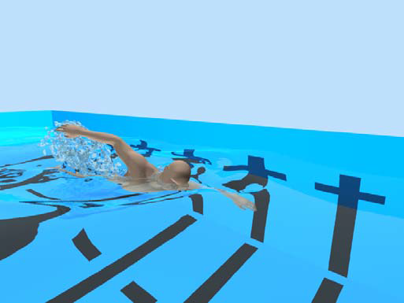
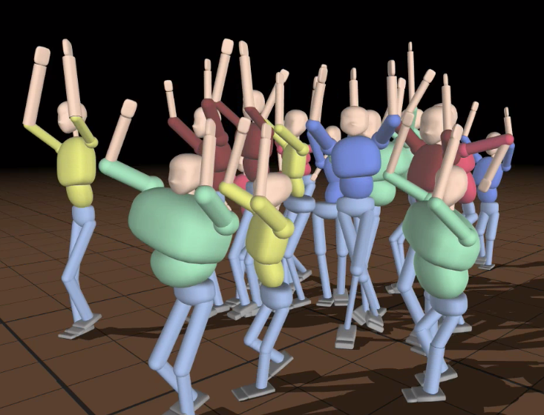
Context
Biomechanical simulation of human swimming [Si2014]
A dancing crowd [coros2010]
Notes:
A dire:
Pb monde complexes ➔ anim physique
Def animation basée physisque.
Dire que chaque controler est très spécifique
Dire que l'on s'intéressera à la marche, immersion partielle, temps réel

Slide 3
Previous works

Slide 4
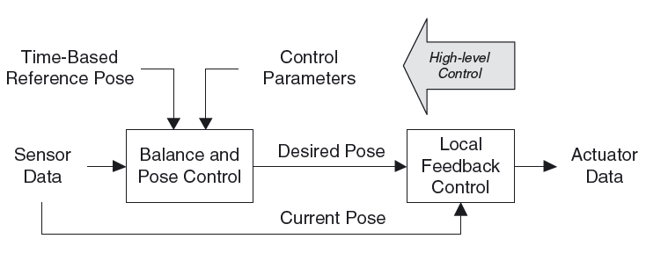
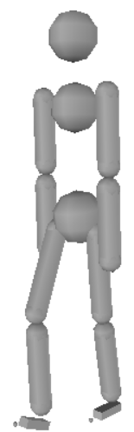
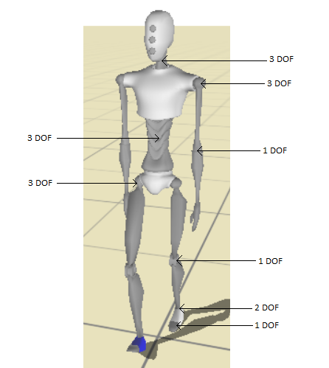
Physic-based controller
Example of physic-based controller [Geijtenbeek2012]
Example of human model

Slide 5
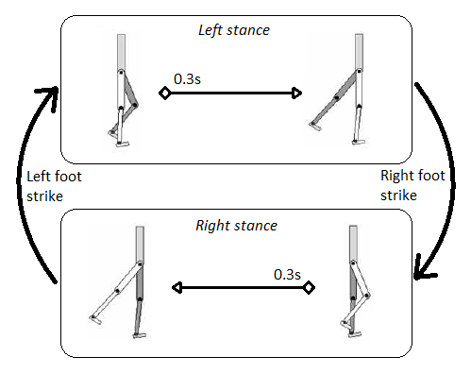
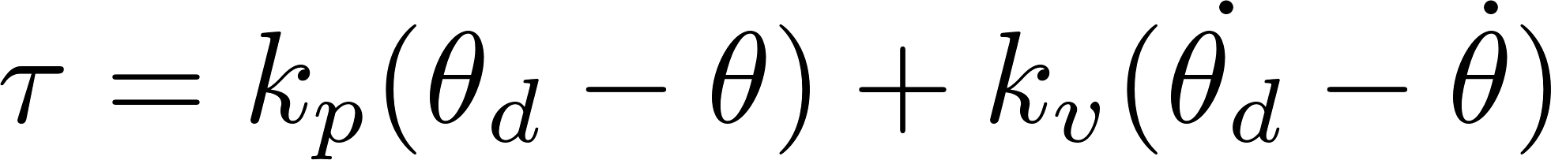
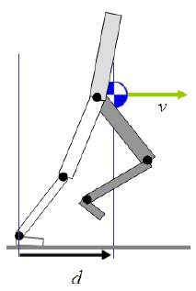
SIMBICON
Proposed by [Yin2007]
PD- controller:
PD-controlled Articulations Feedback
Finite state machine for forward walk [Yin2007]

Slide 6
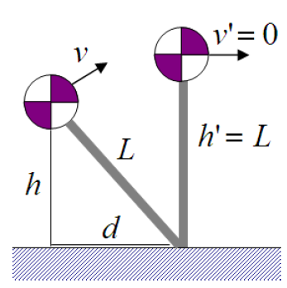
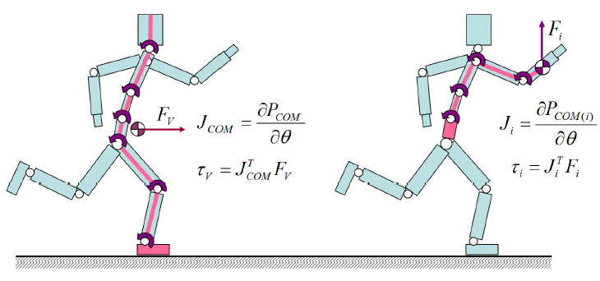
SIMBICON
Stable state combiner [Coros2009]
Gravity compensation [Coros2010]
Inversed pendulum Model (IPM) [Coros2010]
Fine scale velocity and balance control [Coros2010]
Fine scale velocity tuning (left) and gravity compensation (right). [Coros2010]
IPM [Coros2010]

Slide 7
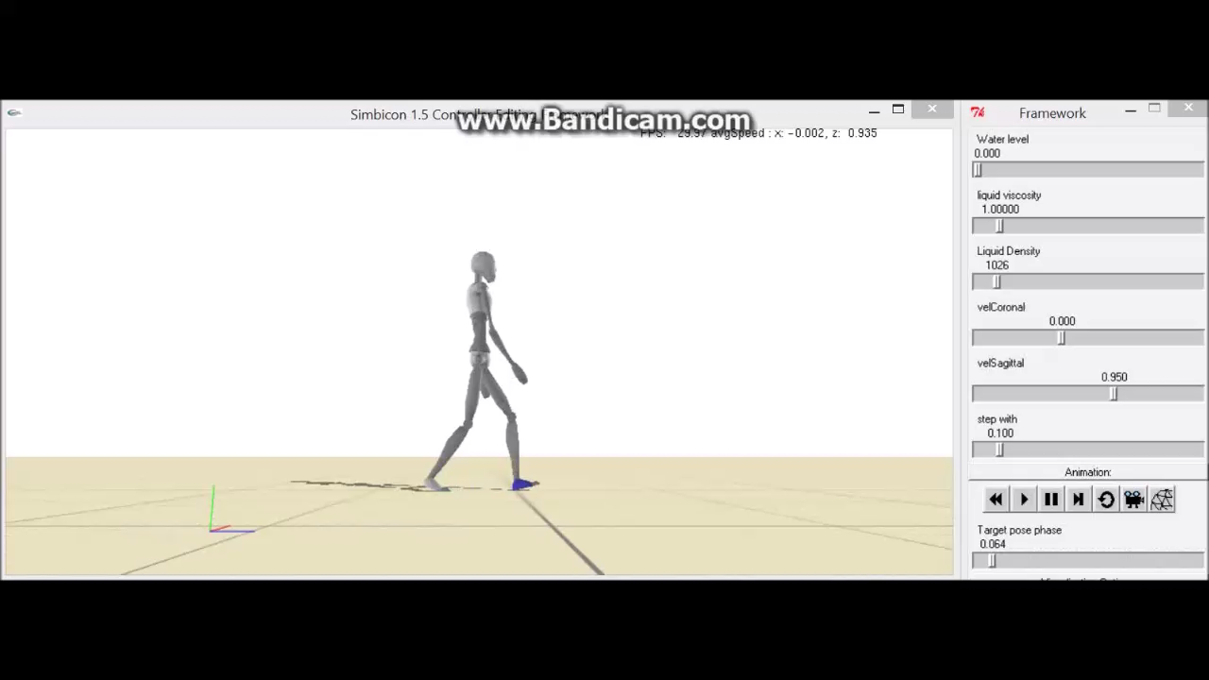
SIMBICON

Slide 8
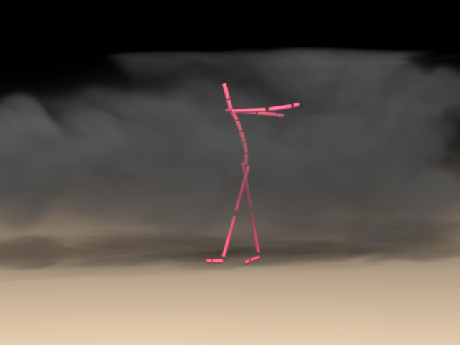
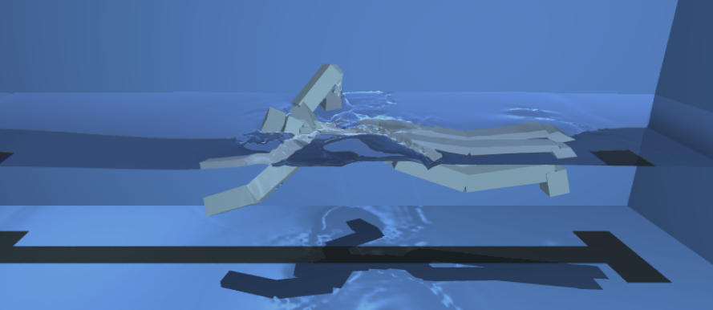
Physic based controllers in fluids
Navier-Stokes equations in Eulerian space
Human swimming driven by motion capture [Kwatra2010]
Human walking under constant wind force [Lentine2011]

Slide 9
Limits and contributions
Limits | Contributions
liquid interactions not in real time | Simplified liquid model
Gait specifications limited | Intelligent IPM usage State combiner
Unable to follow desired speed | IPM alteration Intra-step speed variation consideration
Unable to handle immersion | Immersion aware gravity compensation. Learning based systems.

Slide 10
Contributions

Slide 11
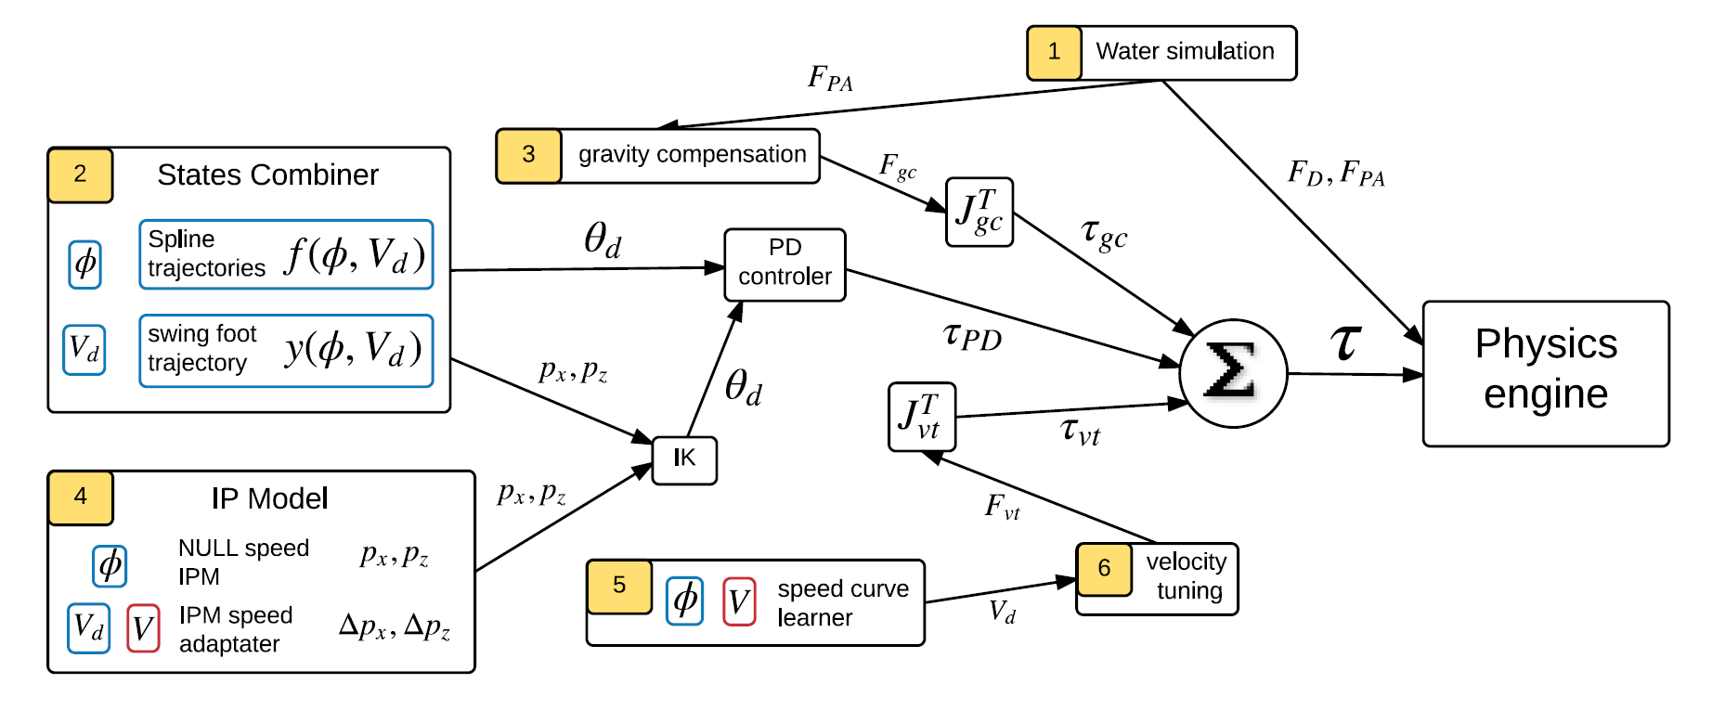
Controller overview

Slide 12
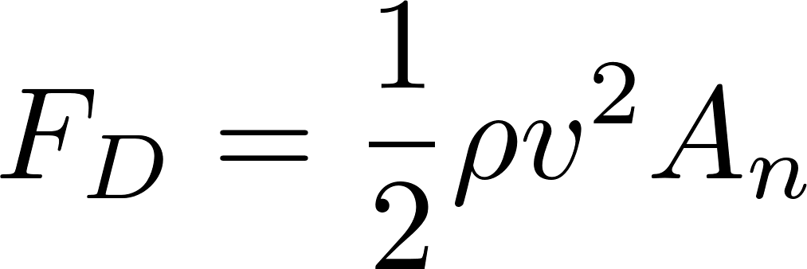
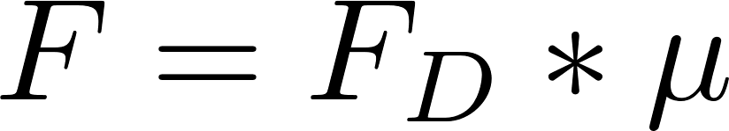
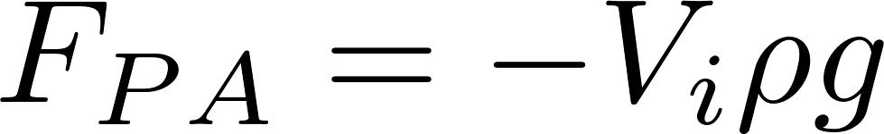
Liquid model
Liquid drag:
Friction:
Buoyancy:
Physic model of our character

Slide 13
Gait Specification: States combiner
Goals:
Define main characteristic of the gait
Define conditions specific gaits
Can be enable on selected joints
Interpolation following a square law

Slide 14
Gait Specification: IPM
Used in the descending phase of each step
User defined swing foot trajectory for ascending phase
IPM override user defined trajectory if the balance is lost

Slide 15
Speed Control
IPM result alteration
Next step nearer ➔ accelerate character
Next step further ➔ slow character
Principle:
Add a Δ to the IPM result.
Adapt the Δ depending on speed at the end of each step

Slide 16
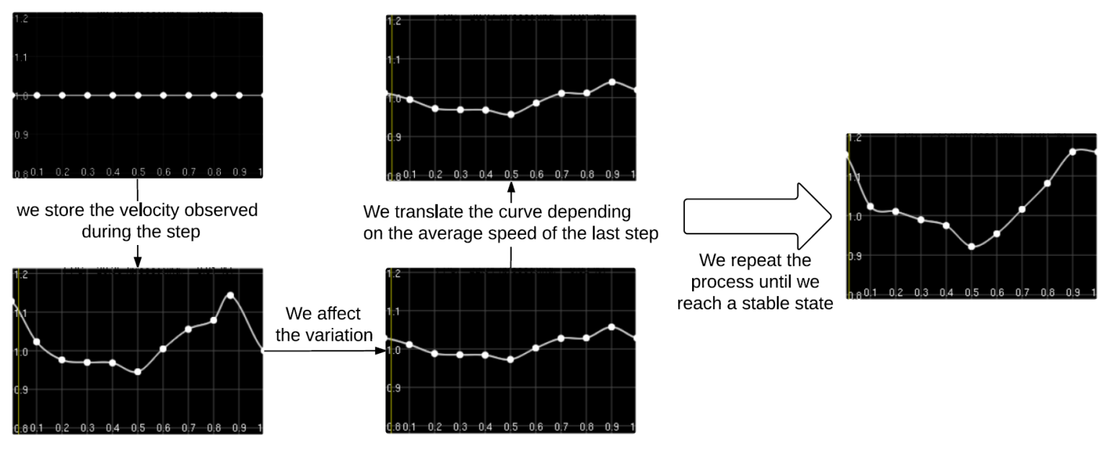
Speed Control
Based on fine scale control from (coros2010)
Goal:
adapt virtual force to intra-step speed variations.
Speed curve learning process

Slide 17
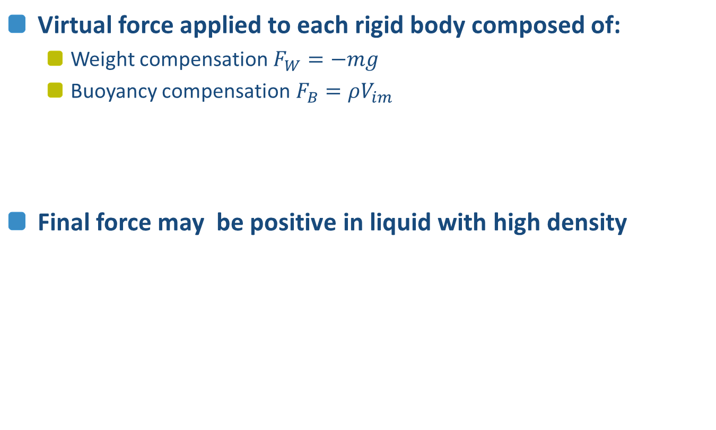
Gravity compensation
Virtual force applied to each rigid body composed of:
Weight compensation$F_{W}=−mg$
Buoyancy compensation$F_{B}=ρV_{im}$
Final force may be positive in liquid with high density

Slide 18
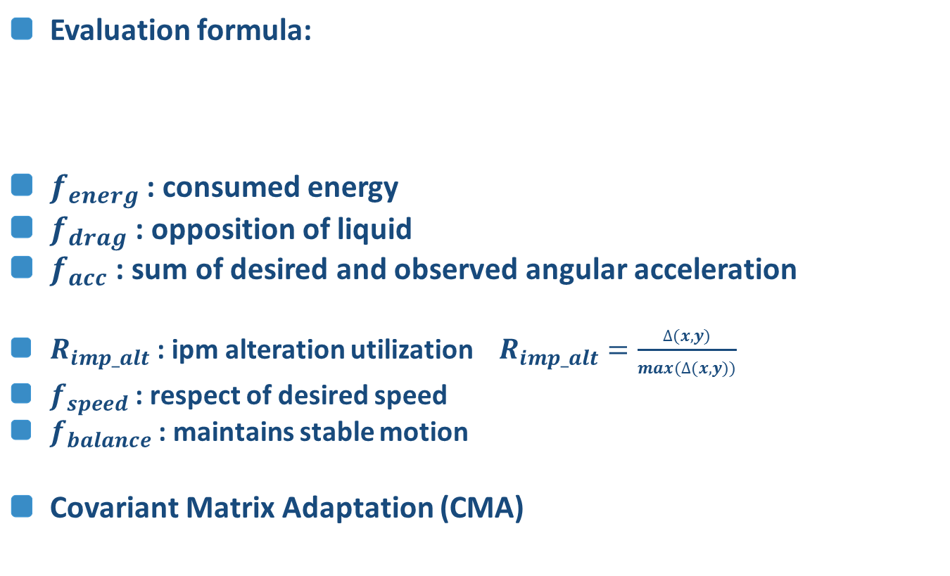
Optimization
Evaluation formula:
$f_{energ}$: consumed energy
$f_{drag}$: opposition of liquid
$f_{acc}$: sum of desired and observed angular acceleration
$R_{imp_alt}$: ipm alteration utilization $R_{imp_alt}=\frac{∆(x,y)}{max(∆(x,y))}$
$f_{speed}$: respect of desired speed
$f_{balance}$: maintains stable motion
Covariant Matrix Adaptation (CMA)

Slide 19
Results

Slide 20
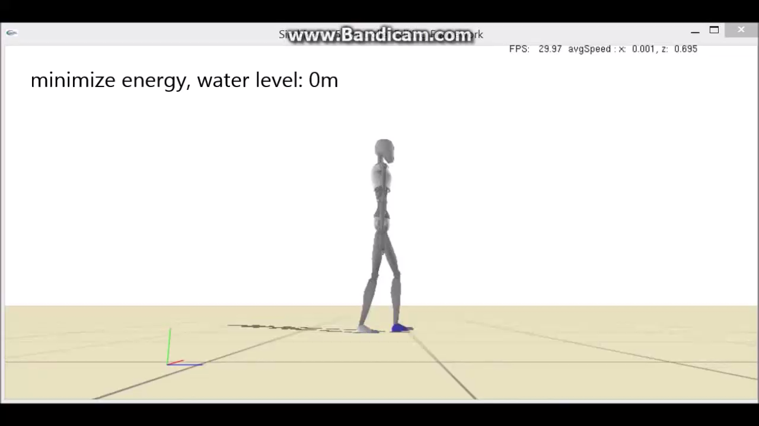
Analyze optimization results
10 reference states (5 liquid levels, 2 speed)

Slide 21
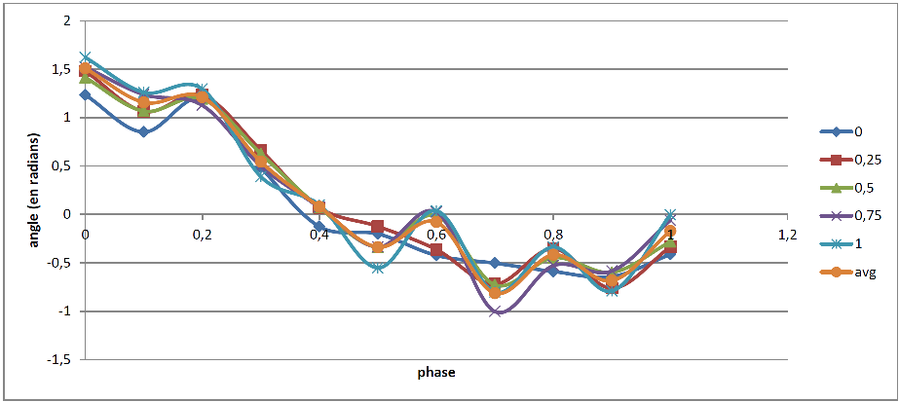
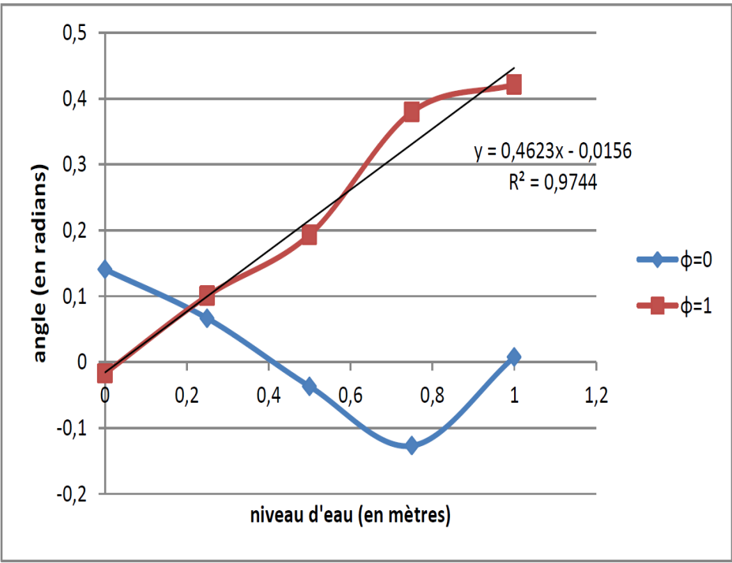
Reference states studies
Significant linear relations between liquid levels
Swing foot trajectory for each liquid level. The average trajectory is the average all the others but the 0m one.
Evolution of the value for each key point of the pelvis-torso articulation depending on the liquid level.

Slide 22
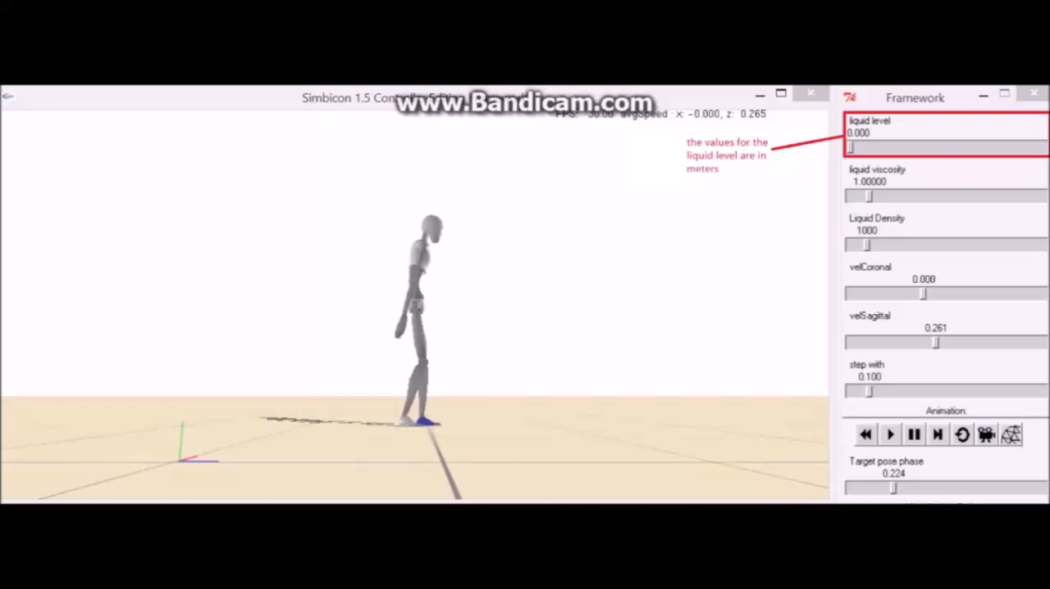
Final controller

Slide 23
Conclusion
Contributions:
Simple liquid through basic hydrodynamics
States combiner
Balance strategy activated on need only
Learning strategy for easy adaptation to liquid
Limits:
Static Thresholds based systems
Unstable contact between foot and ground.
Simplified liquid model may create unrealistic results
Future works:
More realistic liquid model
Extension to more motions and more environments

Slide 24

Questions ?

Slide 25
References
[Coros2009] Coros, S., Beaudoin, P., van de Panne, M. : Generalized biped walking control. In : ACM Transactions on Graphics (TOG). vol. 29, p. 130. ACM (2010)
[Coros2010] Coros, S., Beaudoin, P., van de Panne, M. : Robust task-based control policies for physics-based characters. In : ACM Transactions on Graphics (TOG). vol. 28, p. 170. ACM (2009)
[Geijtenbeek2012] Geijtenbeek, T., Pronost, N. : Interactive character animation using simulated physics : A state-of-the-art review. In : Computer Graphics Forum. vol. 31, pp. 2492–2515. Wiley Online Library (2012)
[Kwatra2010] Kwatra, N., Wojtan, C., Carlson, M., Essa, I., Mucha, P.J., Turk, G. : Fluid simulation with articulated bodies. Visualization and Computer Graphics, IEEE Transactions on 16(1), 70–80 (2010)
[Lentine2011] Lentine, M., Gretarsson, J.T., Schroeder, C., Robinson-Mosher, A., Fedkiw, R. : Creature control in a fluid environment. Visualization and Computer Graphics, IEEE Transactions on 17(5), 682–693 (2011)
[Si2014] Si, W., Lee, S.H., Sifakis, E., Terzopoulos, D. : Realistic biomechanical simulation and control of human swimming. ACM Transactions on Graphics (TOG) 34(1), 10 (2014)
[Yin2007] Yin, K., Loken, K., van de Panne, M. : Simbicon : Simple biped locomotion control. In : ACM Transactions on Graphics (TOG). vol. 26, p. 105. ACM (2007)

